Slide 1


Slide 2


Slide 3
What is a BLOG ??
“…the first journalistic model that actually harnesses rather than merely exploits the true democratic nature of the web. It’s a new medium finally finding a unique voice.”–Andrew Sullivan
A blog is a frequently updated online personal journal or diary. It is a place to express yourself to the world. A place to share your thoughts and your passions. Really, it’s anything you want it to be.

Slide 4
Why Blogging??
We believe the answer lies in the fact that every human has a voice and wishes their voice to be heard.
They may post twenty or thirty times a day, detailing when they ate lunch and when they headed home from work. On the other hand there are bloggers who give almost no detail about their lives, but write instead about a hobby or interest of theirs. They may dedicate their blog to something they are passionate about.

Slide 5
Single Page Application
The term “single-page application” (or SPA) is usually used to describe applications that were built for the web. These applications are accessed via a web browser like other websites, but offer more dynamic interactions resembling native mobile and desktop apps.
The most notable difference between a regular website and an SPA is the reduced amount of page refreshes. SPAs have a heavier usage of AJAX — a way to communicate with back-end servers without doing a full page refresh — to get data loaded into our application. As a result, the process of rendering pages happens mostly on the client-side.

Slide 6
Advantages of SPA
SPA is fast, as most resources (HTML+CSS+Scripts) are only loaded once throughout the lifespan of application. Only data is transmitted back and forth.
The development is simplified and streamlined. There is no need to write code to render pages on the server. It is much easier to get started because you can usually kick off development from a file file://URI, without using any server at all.
It’s easier to make a mobile application because the developer can reuse the same backend code for web application and native mobile application.
SPA can cache any local storage effectively. An application sends only one request, store all data, then it can use this data and works even offline.

Slide 7
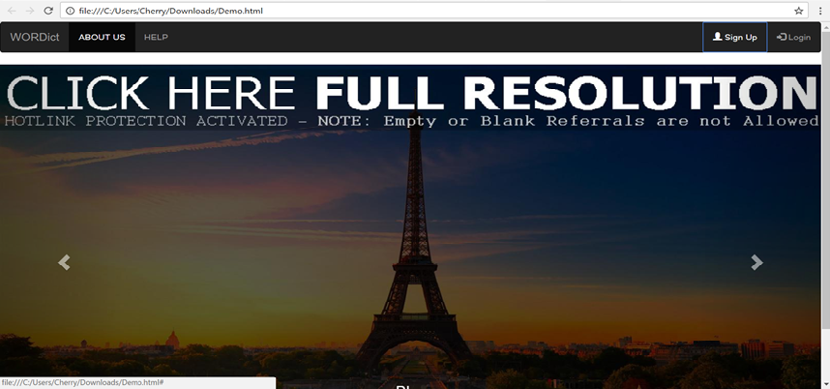
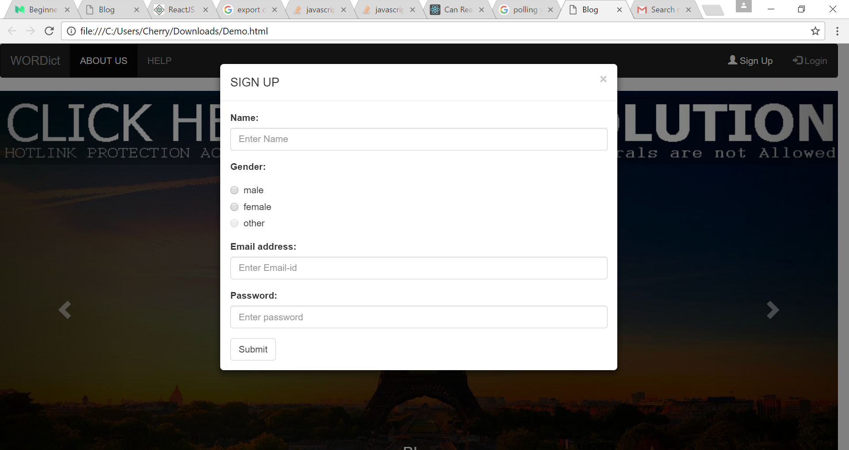
SIGN UP/LOG IN

Slide 8
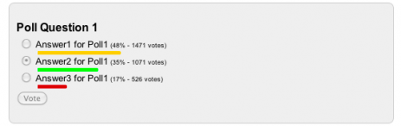
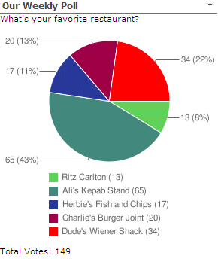
POLLING

Slide 9
Content Filtering
We don’t permit mature content on our website, including text, images and videos that contain nudity, offensive language, and mature subject material. However, blogs that contain such content must be marked as Mature in our system.
However, there are limitations to the mature content permitted on our service. Please don’t:
Post visual depictions of sexually explicit acts (such as, but not limited to, images, videos, and drawings) that can be considered pornographic;
Post links or ads to adult-oriented affiliate networks, such as pornography site signups;
Post links, text, or images promoting or advertising escort or erotic services;
Post images of extreme violence or gore without associated context or commentary;
Post images of child pornography;
Post content that promotes pedophilia, such as blogs with galleries of images of children where the images, content surrounding the images, or the intent of the blog is sexually suggestive.
Blogs found to be hosting the above material will be suspended. In cases of child pornography, we will report all incidences to the National Center for Missing and Exploited Children and fully cooperate with law enforcement.

Slide 10
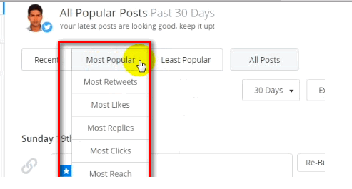
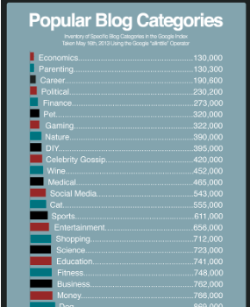
Trending Blogs

Slide 11
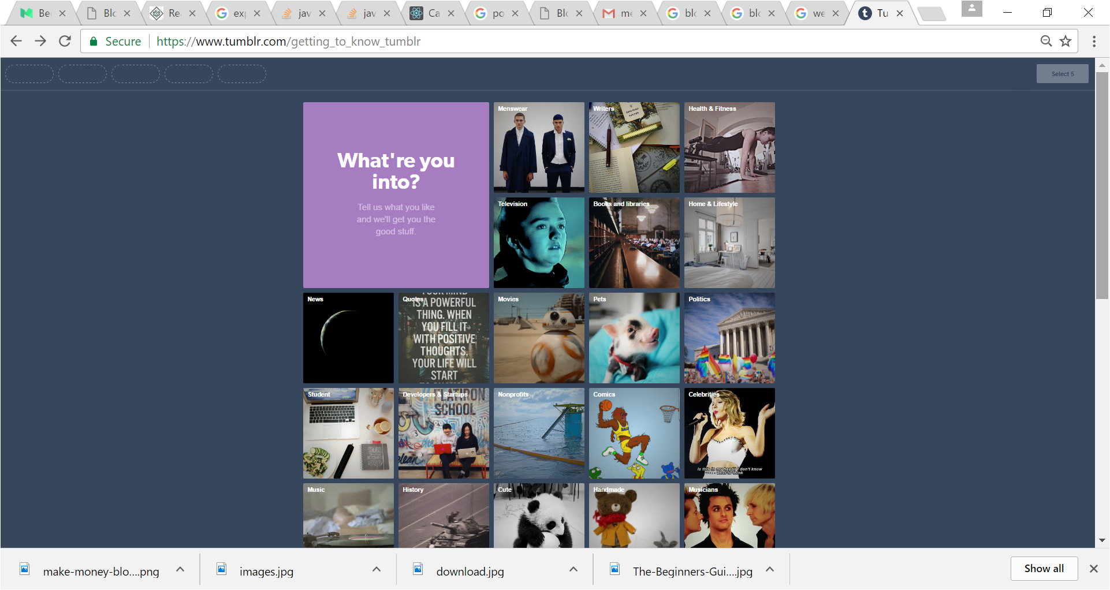
Sorting

Slide 12
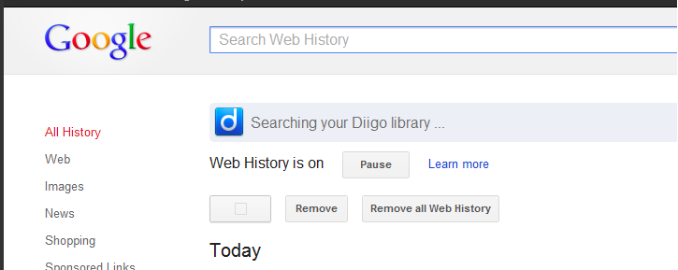
Search History
A user’s web and search history plays an integral part in how they navigate the world wide web. Controlled by individual web sites , the search history works behind the scenes to optimize the browsing experience. Search engines like Google also utilize a form of search history to improve the way information is found.
With that being said, the method of tracking previous web activity is not perfect. The technology has advanced tremendously since the early days of internet browsing, but there are still many negative implications that may arise. It’s important to fully understand what a search history is, how it works, and how to stay protected.

Slide 13
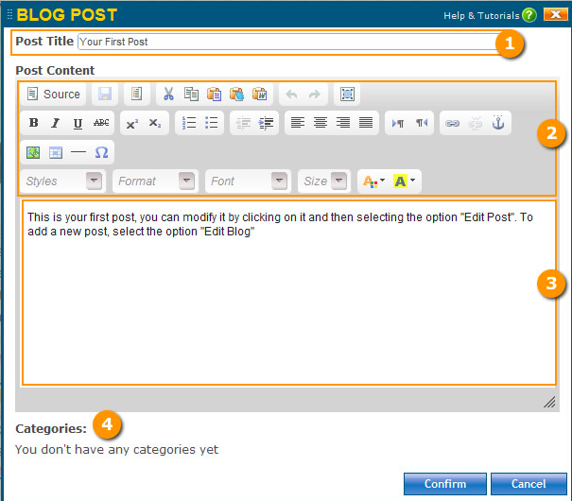
Blog Editor

Slide 14

Notifications

Slide 15



Like , Comment and Follow

Slide 16
Technologies
React Js
Meteor

